Slide 1
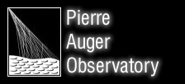
Muon Detection with Resistive Plate Chambers (vis a vis MARTA upgrade proposal)
Joseph Berlin
Penn State University
Auger Data Analysis Meeting, Oct. 2013

Slide 2
…special thanks to Peter Mazur and Argonne Lab for three RPC units and critical expertise in getting these trials started.

Slide 3
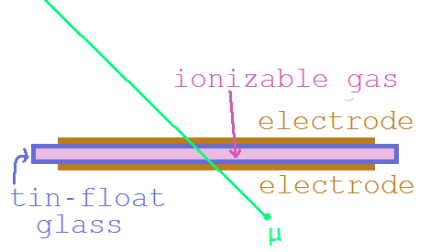
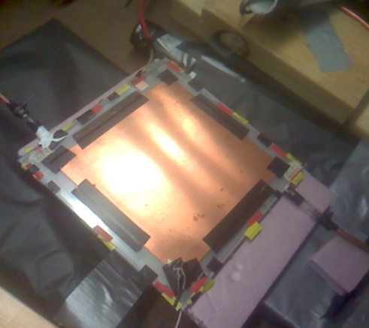
Resistive Plate Chambers (RPC)
Two high-resistivity glass plates (2mm thick) with a uniform 1mm gap and uniform high-voltage between them. Electrodes on opposite, exterior sides: 16.5cm x 16.5 cm.
Induction in the electrodes produces telltale pulses
In these studies, we used pure R-134a (MARTA) and mixtures of R-134a, Argon and Isobutane

Slide 4
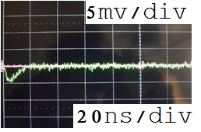
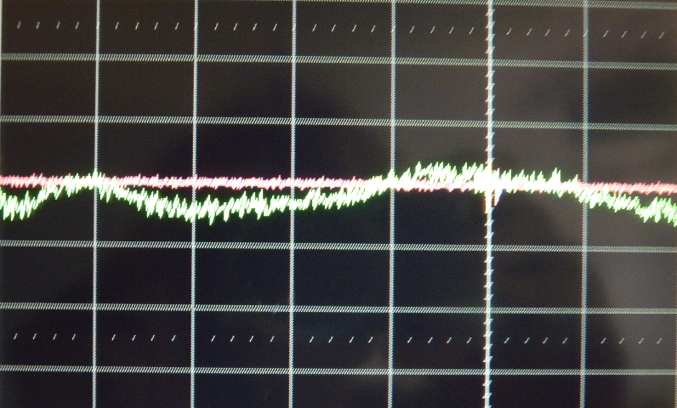
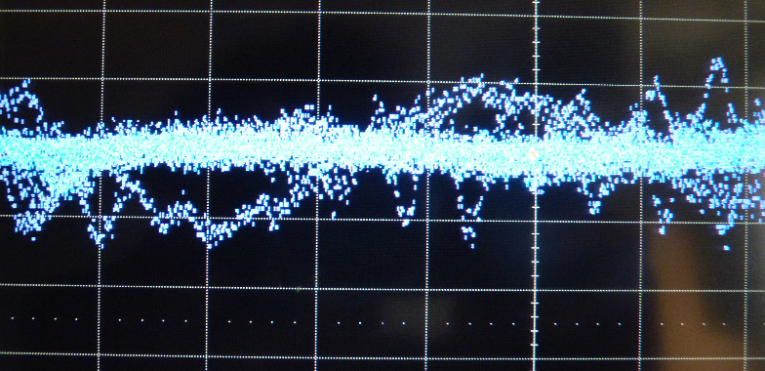
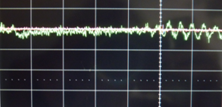
Avalanche Mode
Avalanche mode
Short duration (~5-20 ns at base)
Single-peaked
Consistent response time (+- 10 ns)
Amplitudes ranging ~1→30 mV.
Ball lightning
Electronic noise buries these pulses in our experiment, but they could be distinct from null-signal on quieter electronics and/or less noisy RPC

Slide 5
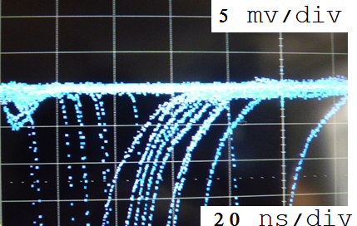
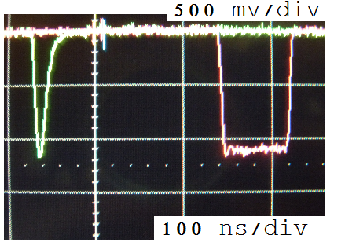
Streamer Mode
Streamer mode
Long duration (50ns-1μs at base) – variation between gasses
Amplitudes ranging 100 mV → 5,000 mV
Inconsistent response time (variable time lag of 1→100 ns).
Always proceeded by or simultaneous with an avalanche
Dominates at high voltages
Lightning Bolt

Slide 6
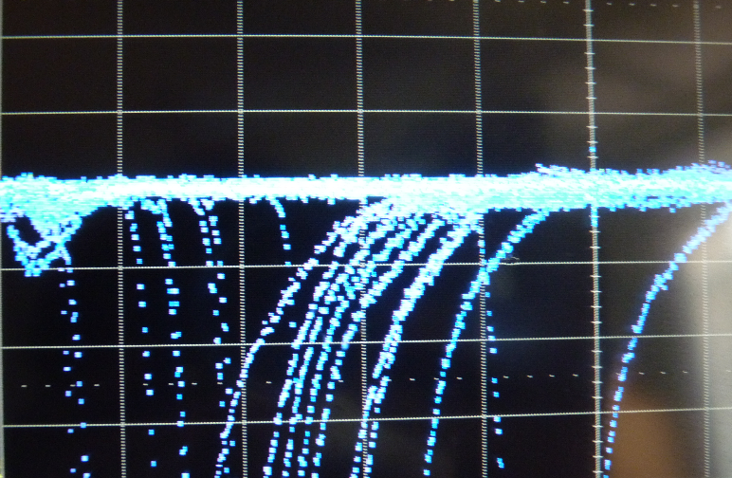
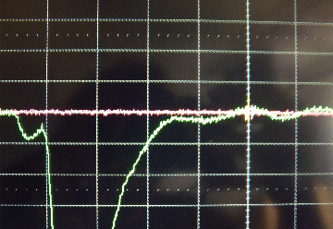
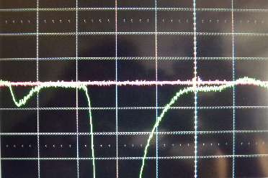
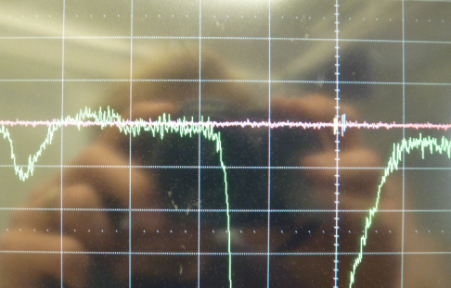
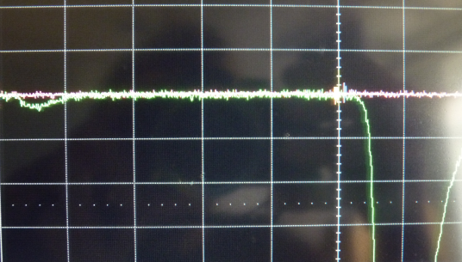
Mixed Modes
Streamers are always preceded by or concurrent with avalanches.
Area histograms suggest multiple pulse types within the streamer population (see histograms)

Slide 7
Roles of Gasses
Argon:
most easily ionized , runaway streamers if unquenched
R-134a
UV-absorptive, electronegative (quenches streamers).
Isobutane
Improves efficiency when introduced into Argon + R-134a mixture, and makes pulses sharper.
Quenches very large 3-component streamers (steals Argon’s thunder)

Slide 8
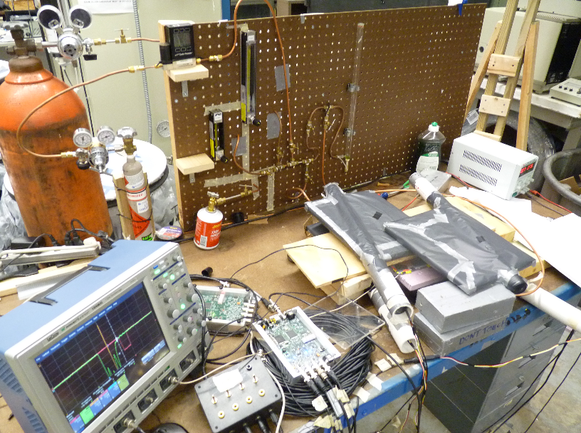
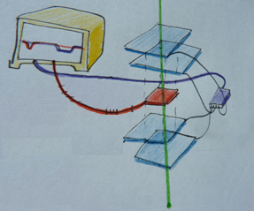
Efficiency and Pulse Profiles
RPC (red) sandwiched between
overlapping scintillator paddles (blue)
QuarkNet (purple) applies 4-fold
coincidence condition, outputs TTL pulse
Oscilloscope triggers on TTL pulse
Area, Amplitude and width measurements of RPC pulse (red) are recorded
Efficiency defined as the % of TTL pulses that also show a streamer in the RPC (red).
*An estimated ‘streamers + avalanches’ efficiency is also presented. This includes, as positive signal, small avalanches that were distinguishable as real signal by eye but were indistinguishable from null-signal in area and amplitude histograms due to persistent electronic noise.
*A small sample of non-streamer events are extrapolated to estimate the portion that exhibited avalanches (at each voltage/mixture).

Slide 9
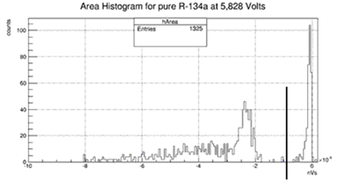
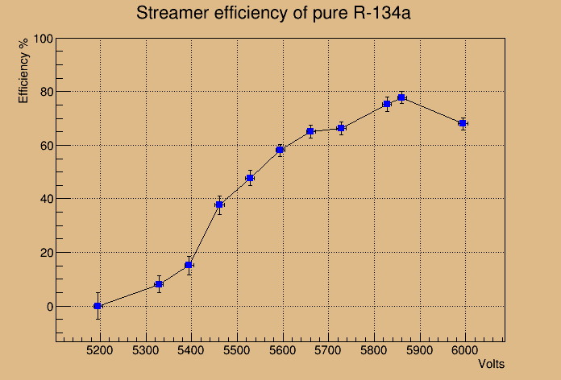
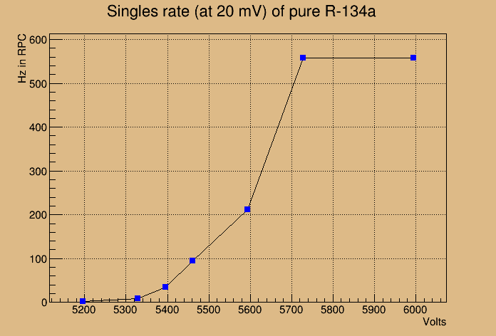
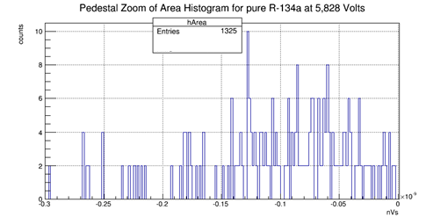
pure R-134a (MARTA)
Singly-peaked avalanches and streamers (well-quenched, trains of quenched streamers at high voltages).
*By eye, 75% (+/- 12.5%) of pedestal (non-streamer) events
were avalanches at 5,828 V. By eye, 73% (+/-12.7%) of
pedestal (non-streamer) events at 5,861 V were avalanches
(their respective efficiencies thereby increase from 75% to
94% and from 78% to 95% - not plotted because only two
voltages were tested this way). Area histogram of pedestal
includes both null-signal and avalanches)shows no way to
discriminate with simple area/amplitude cuts.

Slide 10
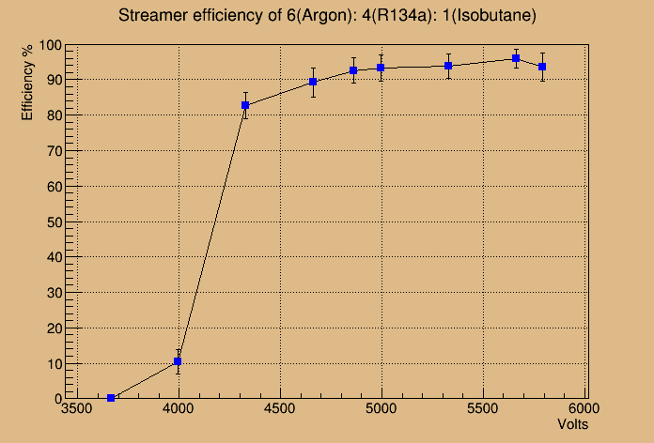
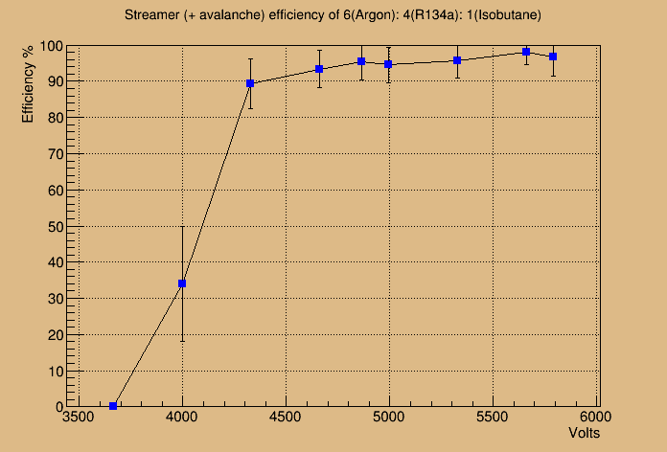
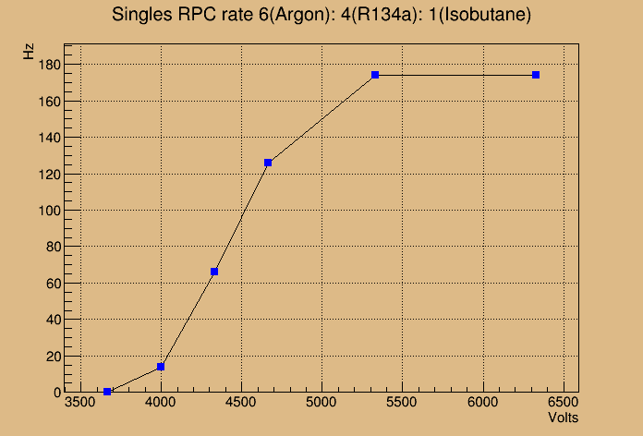
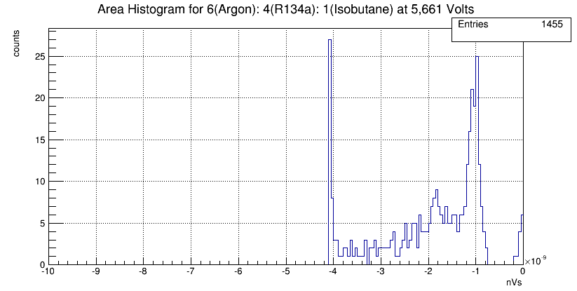
6 : 4 : 1 Argon : R-134a : Isobutane

Slide 11
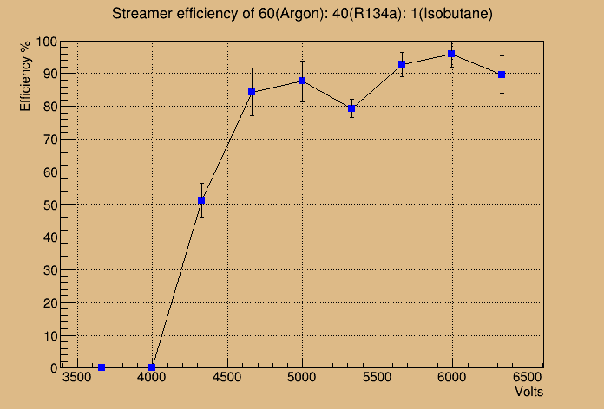
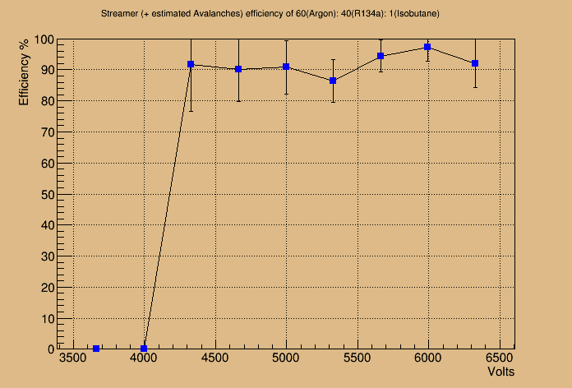
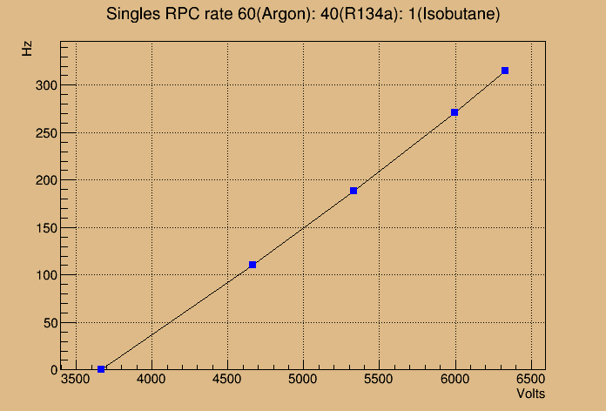
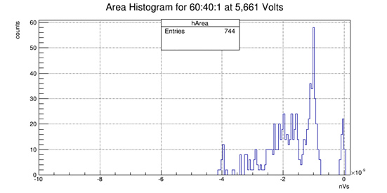
60 : 40 : 1 Argon : R-134a : Isobutane

Slide 12
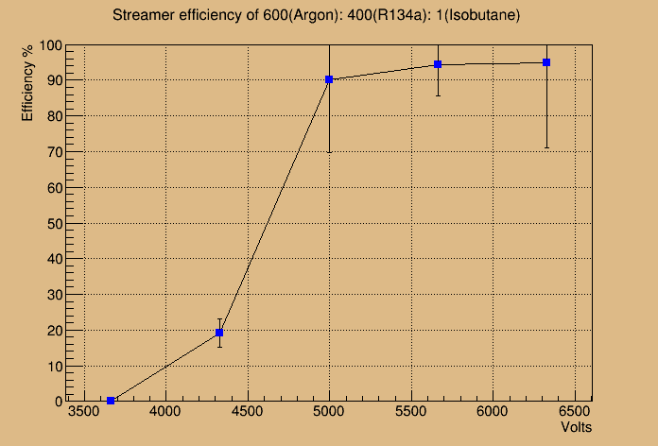
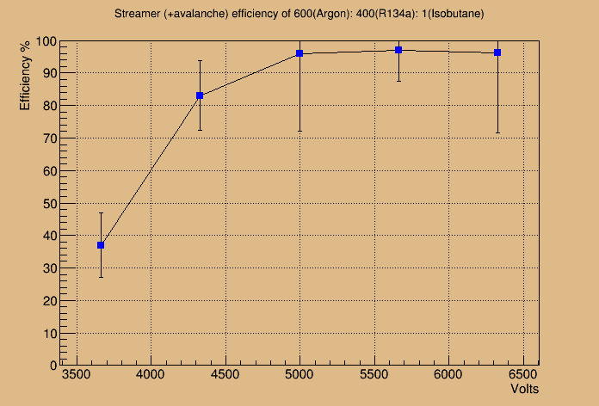
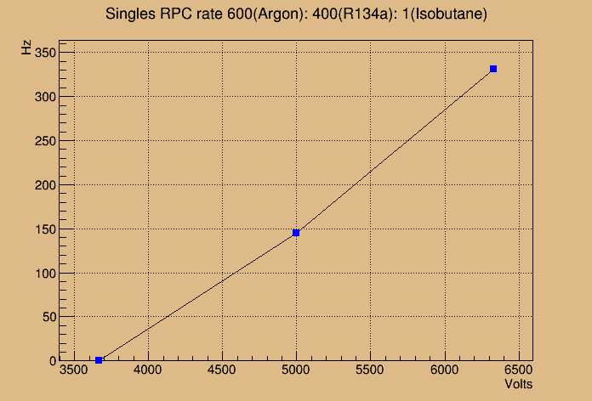
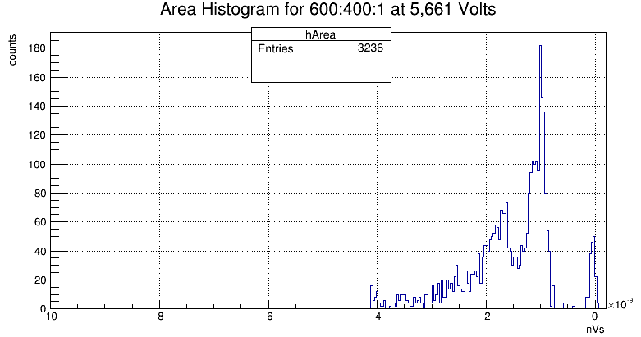
600 : 400 : 1 Argon : R-134a : Isobutane

Slide 13
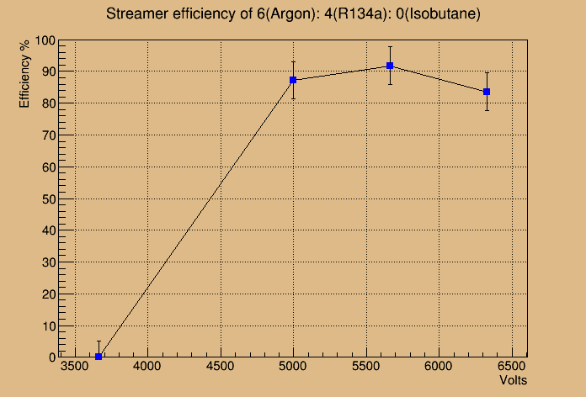
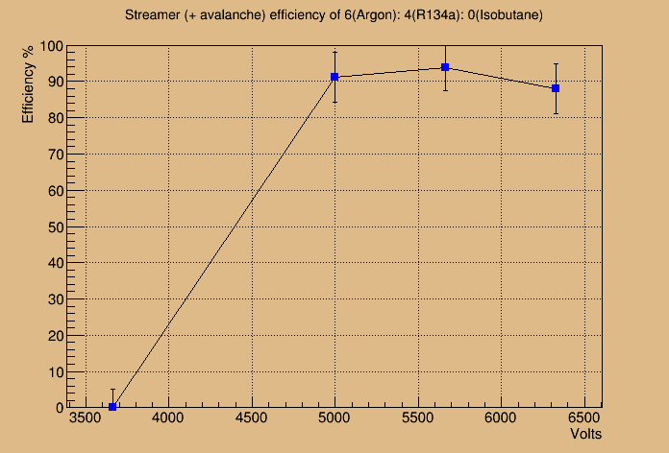
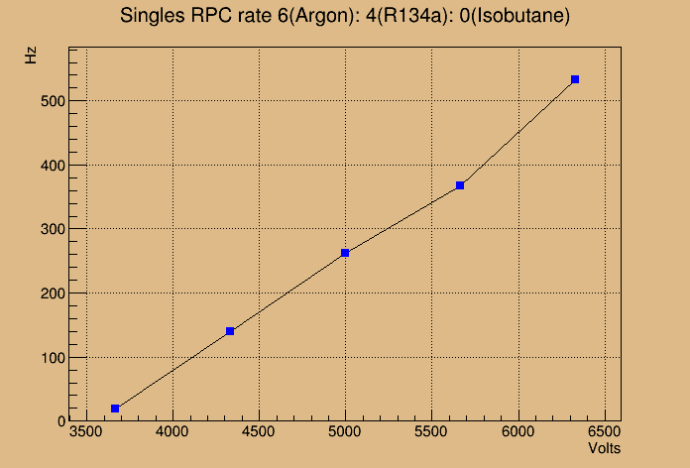
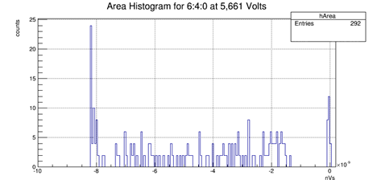
6 : 4 : 0 Argon : R-134a : Isobutane

Slide 14
Considerations
Gas flow considerations:
A rate of gas flow matters in relation to the volume of the chamber. A big chamber with some flow rate will stagnate faster than a small chamber with the same flow rate (chemistry).
A long gas-flow-path through the RPC may well change local RPC efficiency (i.e. there is always relatively stale gas near the RPC outlet, decreasing or increasing sensitivity locally in the RPC)
The flow rate and chamber size determine the pressure in the chamber, which determines the density of gas in the chamber, which changes behavior.
Arrival direction sensitivities
Perpendicular to Plate (vertical) = short path through gas (more likely to avalanche as opposed to stream?)
Very inclined (near horizontal)= long path through gas (more likely to stream as opposed to avalanche?)
Chamber specifics (gap width, resistive plate type) may be major factors behind relative efficiencies of gas mixtures.
A μm gap might favor barely-ionizable gasses, whereas Argon (streamer-happy) in a big 10mm gap might exhibit avalanche behavior (too wide to allow for conduction path to stay open).
MARTA RPCs have 2x 1mm gaps with 3x 2mm glass plates (somewhat comparable).

Slide 15
Ideas
Stalactite/stalagmite shaped glass plates
You decrease your sensitive areas to a grid of locations, but perhaps we can use unquenched gasses, like Argon alone, to produce geometrically isolated conduction nodes.
Geometrically quenched
Honeycomb structure between flat glass surface
Isolating small volumes to localize avalanches or streamers
UV-opaque, EM-Interfering cubicles
Wall-quenched
MARTA: intervening resistive layer (glass) between two gas chambers to prevent streamers.
R-134a-laden Aerogel dielectric btw. plates (similar to MARTA intervening layer, but many thin bubble-walls)

Slide 16
Conclusions
Pure R134-a exhibits high efficiency to muons (95%) when operated above about 5800 Volts in streamer + avalanche mode.
This requires a very quiet electronic environment.
If discriminating using only streamers, efficiency maxes out at ~78% (for up to 6,000 volts).
R-134a streamers are almost always singly-peaked, but can come in trains of pulses.
2-gas mixture, roughly optimized as 3:2 ratio of Argon:R134-a, exhibits efficiencies of up to 94% (including avalanches) or 92% (streamer-only)
3-gas mixture, roughly optimized as a 6:4:1 ratio Argon:R-134a:Isobutane, can exhibit efficiencies of up to 98% (including avalanches) or 96% (streamer-only)
Pulses, of both modes, are well defined (single-peaked, short duration)
Even if only streamers are distinguishable from noise, efficiency still tops 96% at 6,000 V
Decreasing the amount of Isobutane in this mixture by a factor of 100x hardly effects efficiency (97% including avalanches, 95% streamer-only).
Isobutane seems to quench very large pulses.

